Slide 1
Parts Crib database
Project Name: Humber parts
by: Masoud rahguzar

Slide 2
Introduction
As a student in the Computer Engineering Technology program, I will be integrating the knowledge and skills I have learned from our program into this Internet of Things themed capstone project. This proposal requests the approval to build the hardware portion that will connect to a database as well as to a mobile device application. The internet connected hardware will include a custom PCB with sensors and actuators for Parts Crib Database. The database will store information of students whom rent out items from the parts crib. The mobile device functionality will include list amount of each item in the parts crib and how many are left after being rented out and will be further detailed in the mobile application proposal. I will be collaborating with the following company/department Humber College Information Technology. In the winter semester I plan to form a group with the following students, who are also building similar hardware this term and working on the mobile application with me are Rafil Yashooa and Divesh Oree. The hardware will be completed in CENG 317 Hardware Production Techniques independently and the application will be completed in CENG 319 Software Project. These will be integrated together in the subsequent term in CENG 355 Computer Systems Project as a member of a 2 or 3 student group.

Slide 3
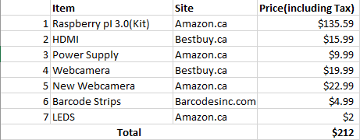
budget

Slide 4
Schedule

Slide 5
Build Video
https://masoud647.github.io/

Slide 6
Knowledge from Previous courses
Semester 1
Tech 101: Electrical Circuits
Tech 103: Digital Fundamentals
Semester 2
Tech 150: Electronic Devices and Circuits
Tech 151: PC Hardware and Operating Systems
Semester 4
CENG 256: Internet Programming

Slide 7
END Thank you for listening

